Slide 1

Correspondence Analysis Young People Survey
Gagana Uday Kumar
WOV797
Notes:
Hello, I am Gagana Uday Kumar. I choose Correspondence analysis for my final project, and I wish to declare a bonus slide and would take 1 min extra for the same.

Slide 2

OBJECTIVE
ANALYZING THE RELATIONSHIP BETWEEN EDUCATION AMONG THE YOUNG PEOPLE AND THEIR INTERNET USAGE
Notes:
I found this survey dataset on Kaggle called young people survey and it contains details of students of the Statistics class at FSEV UK where they were asked to invite their friends to participate in this survey.
Our main objective from this dataset is to analyze the relationship between education among the young people and their internet usage.

Slide 3
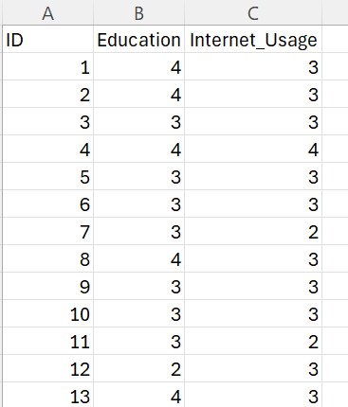
Data Source
The data file is a survey data which consists of 1010 rows and 150 columns.
All participants were aged between 15-30
The variables can be split into the following groups: Music preferences, Movie preferences, Hobbies & interests, Phobias, Health habits, Personality traits, views on life, & opinions, Spending habits, Demographics
Notes:
This dataset includes a lot of details broadly on Music preferences, Movie preferences , Hobbies & interests, Phobias, Health habits, Personality traits, views on life, & opinions, Spending habits and Demographics which consists of 1010 rows with 150 columns of which I have selected internet usage and education to explore if there was a relationship between them.

Slide 4
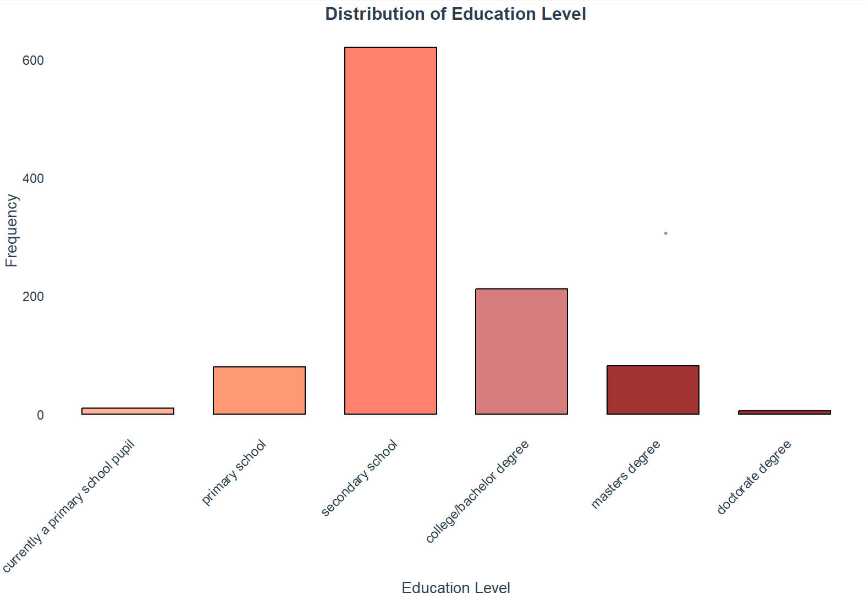
Education Variable
currently a primary school pupil
primary school
secondary school
college/bachelor degree
Master’s degree
doctorate degree
Notes:
Students were asked to select their education level range from 6 levels.
This is a pretty clean data and no missing values could be found and hence I found 1010 responses.

Slide 5
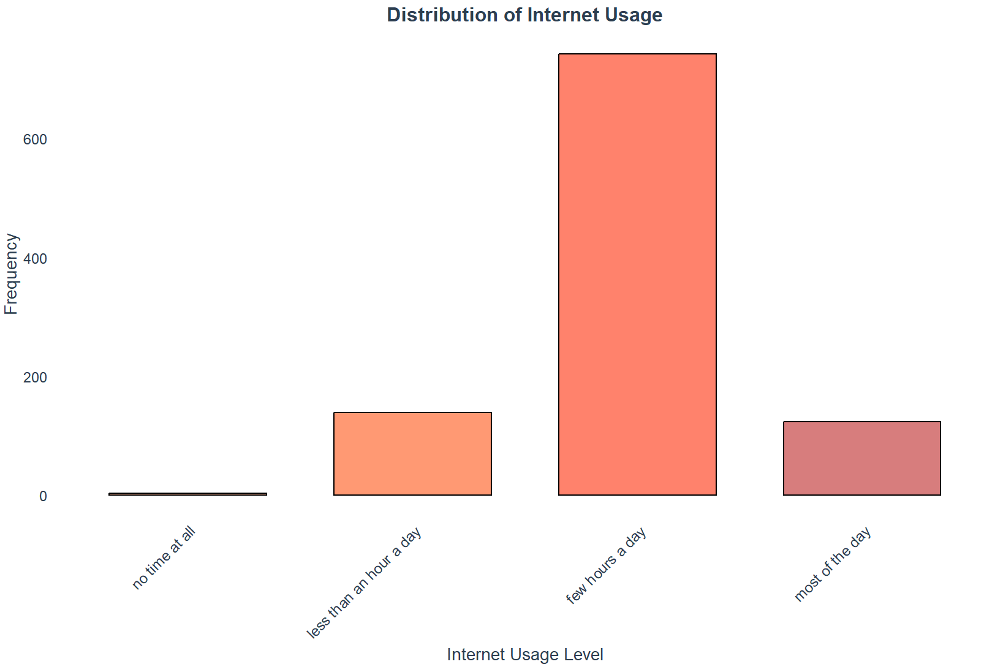
Internet Usage Variable
no time at all
less than an hour a day
few hours a day
most of the day
Notes:
Students were asked to select their internet usage range from the above mentioned 4 levels.
I found 1010 responses for the same too.

Slide 6
What is correspondence Analysis
Correspondence Analysis (CA) is a multivariate statistical technique used for analyzing the relationships between categorical variables in a contingency table.
It is particularly useful for exploring the associations between two or more categorical variables and visualizing these relationships in a low-dimensional space.
Notes:
Since this survey collected data on multiple categorical variables, correspondence analysis was a good choice for examining relative relationships between my two variables education and internet usage.
correspondence analysis relies on certain assumptions to be valid.
- First, the variables must be nominal or categorical
- The categories in each variable should be independent of each other.
- And for this method, there is no assumption of distribution normality

Slide 7
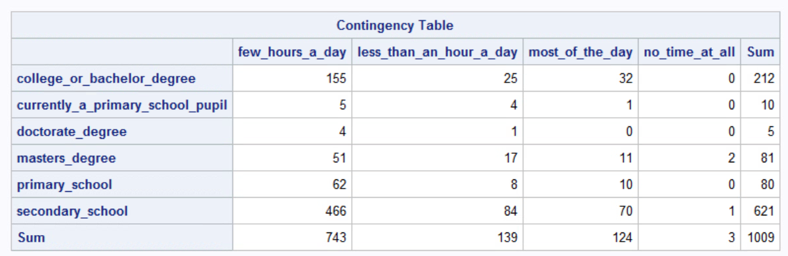
Contingency Table
Notes:
A contingency table is a useful tool for displaying the relationship between two or more categorical variables. But here It's difficult to visualize relationships between variables beyond the raw counts between education and internet usage

Slide 8
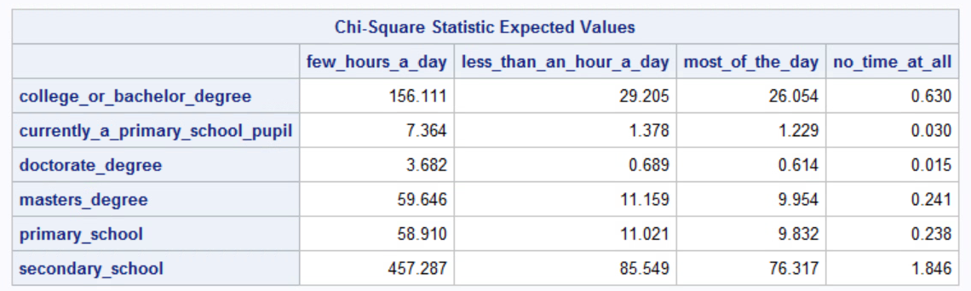
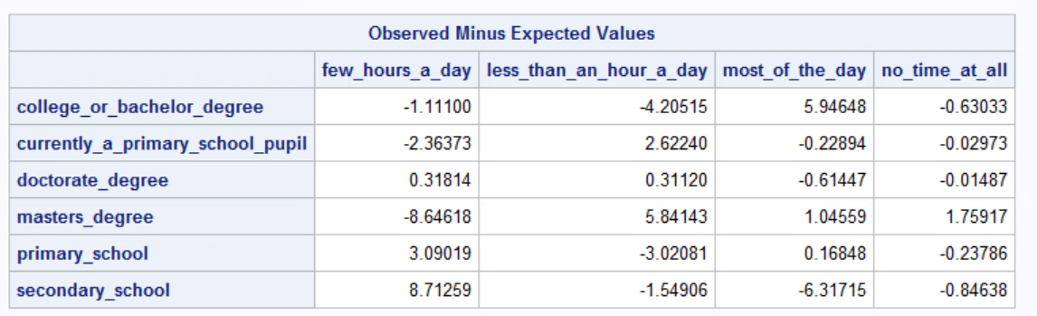
Expected Vs Observed - expected
Notes:
On this slide, there are two tables:
Expected Values: These are the counts expected for each cell in the contingency table if education level and time spent online are independent.
Observed Minus Expected Values: This shows the difference between observed and expected counts, indicating stronger or weaker relationships in specific categories.
Key Observations are that
People with college or bachelor degrees spend most of the day online more often than expected (+5.95).
Those with secondary education spend a few hours online significantly more often than expected (+8.71) and spend less time online overall than expected.

Slide 9
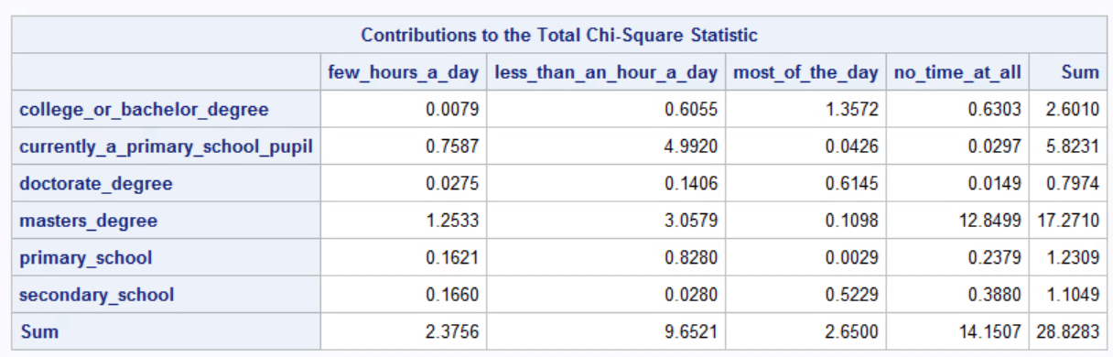
Chi-square contribution
Notes:
In this slide, we're looking at how each category of education level and internet usage contributes to the overall chi-square statistic.
Masters degree holders who don’t spend any time online make a big impact on the statistic, suggesting a strong relationship between high education and no internet use.
Primary school pupils who spend less than an hour online also contribute significantly, indicating a pattern in their internet usage.
On the other hand, the primary school level contributes very little when we consider the "most of the day" category of internet usage.
Similarly, college or bachelor’s degree holders who spend a few hours a day online contribute very little, indicating that these combinations don't affect the overall chi-square statistic much.

Slide 10
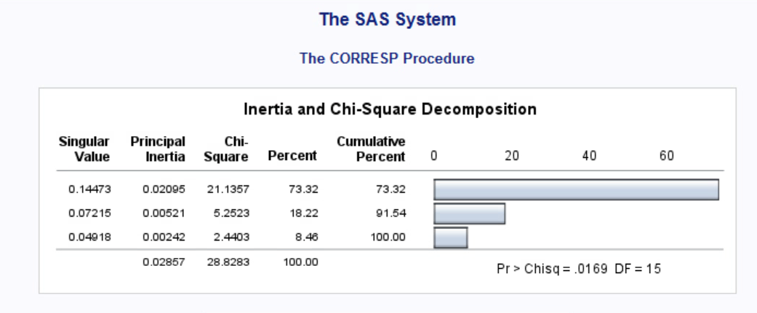
Chi-square
Notes:
In this slide, the p-value of 0.0169 and degrees of freedom of 15 show our results are statistically significant. This means there’s a relationship between the variables, not just random chance. We can reject the null hypothesis that there’s no association, and instead accept the alternative hypothesis, showing a connection between different education levels and internet usage patterns.

Slide 11
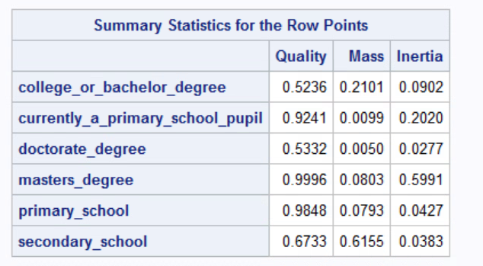
Summary statistics for row points
Notes:
In this slide, quality values tell us how well the data points are represented. Closer to 1 is better, so "masters_degree" and "primary_school" are well represented. On the other hand, "college_or_bachelor_degree" and "doctorate_degree" have lower quality values, so they’re not as strong.
Mass values show how much of the total data each category represents. "Secondary_school" and "college_or_bachelor_degree" take up significant portions, highlighting their importance in the analysis.
Inertia values measure each category's contribution to data variation. Higher inertia, like 0.5991 for "masters_degree," shows a strong influence on the overall variance, pointing to interesting patterns or associations.

Slide 12
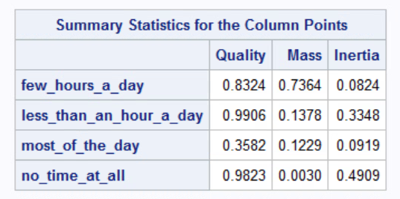
Summary statistics for column points
Notes:
In the summary statistics for the column points, here are the key takeaways:
"less_than_an_hour_a_day" has the highest quality and the lowest quality is in "most_of_the_day".
"few_hours_a_day" has the highest mass and "no_time_at_all" has a low mass. The highest inertia is in "no_time_at_all" and "few_hours_a_day" has the lowest inertia. These insights help us understand how different categories influence the analysis and how data is distributed across them.

Slide 13
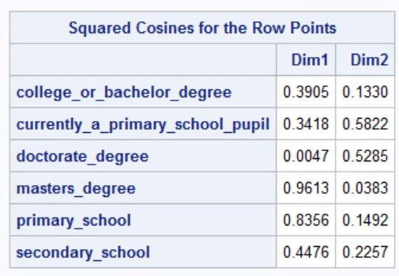
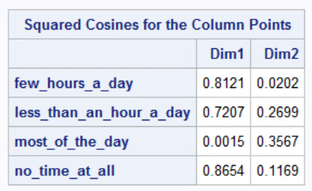
Bonus - squared cosines
Notes:
The squared cosines help understand how each category (row point) is associated with the principal dimensions (Dim1 and Dim2) in the correspondence analysis. Points with high squared cosines on a dimension are strongly associated with that dimension, suggesting that the categories are contributing significantly to the interpretation of that dimension. Conversely, low squared cosines imply that a category does not contribute much to a particular dimension.
In the tables, we can see the squared cosines for the row points and column points across the two dimensions. For instance, "master's degree" is well-represented in Dim1, while "currently a primary school pupil" is strongly associated with Dim2. Similarly, for column points, "few hours a day" is closely linked with Dim1, whereas "most of the day" is more aligned with Dim2. This information helps us understand which categories contribute most to the interpretation of each dimension.

Slide 14
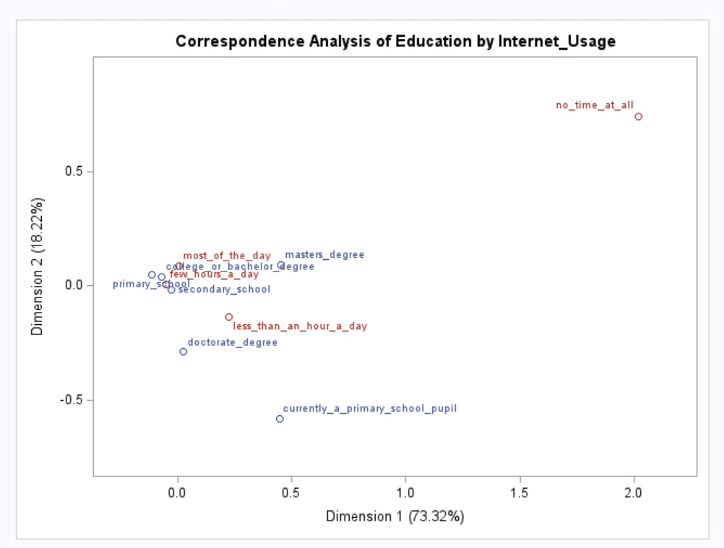
correspondence map
Notes:
Here is the Correspondence Analysis Plot. Internet_usage is shown in red, education is in blue.
Dimension 1 explains 73.32% of the variance and Dimension 2 explains 18.22% of the variance.

Slide 15
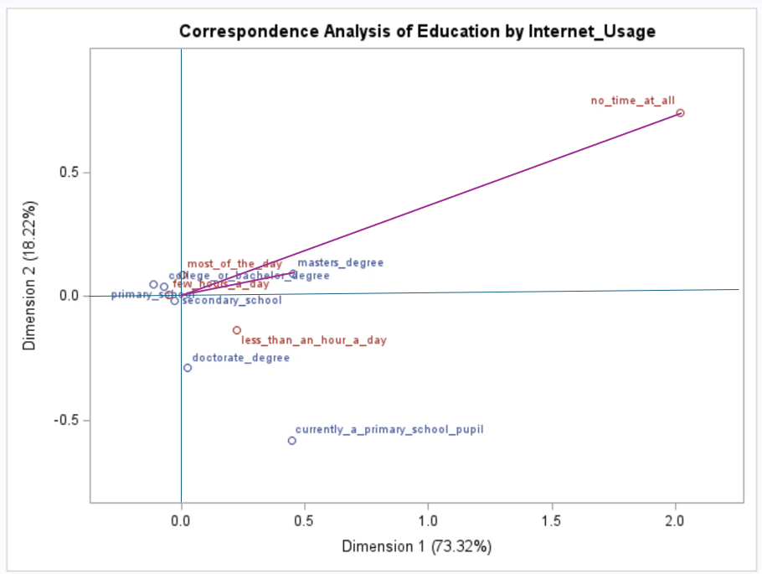
Example of strong association
Notes:
Here is an example of a strong association between a master's degree from the education category and the "no time at all" option for internet usage. This relationship is notable because the "no time at all" category is distant from the origin, indicating a clear differentiation. Additionally, the small angle between the row and column labels and the origin suggests a strong association between a master's degree and not using the internet at all.

Slide 16
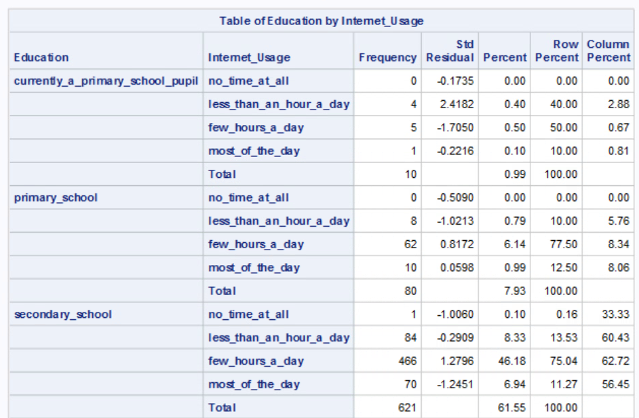
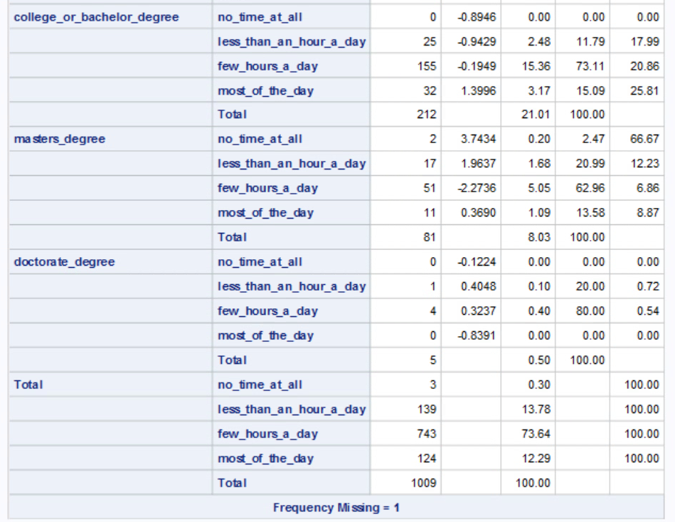
standardized adjusted residuals
Notes:
This table shows the relationship between education levels and internet usage. Key points include:
We use standard residuals to spot significant cells, with highlighted cells indicating a strong influence on the results.
High internet usage is found among individuals with primary and secondary education, most of whom spend a few hours a day online.
In contrast, those with a master's degree tend to use the internet less frequently, either for less than an hour a day or not at all.
There’s a trend where higher education levels (like bachelor's, master's, and doctorate degrees) are linked to less frequent internet usage.
These insights suggest education levels may play a major role in shaping internet usage patterns.

Slide 17
Conclusion
Association between Education and Internet Usage: The analysis reveals a relationship between education levels and internet usage patterns.
Specific Trends: Higher education levels, such as master's degrees, tend to be associated with little to no internet usage.
Influence of Education: Education significantly shapes internet usage behavior, indicating the need for targeted interventions.
Variability in Usage: There is notable variation in internet usage across education levels, affecting access to information and opportunities.
Policy Implications: The findings can guide policies to improve digital access and literacy, bridging gaps across different education levels.
Notes:
Based on the data and analysis presented, the following conclusions can be drawn:
These conclusions highlight the need for strategies to address digital inclusion and support diverse needs in internet usage.

